Slide 1
Capstone Project

Slide 2
Project Details
Project Name : HR Analytics
Batch Name : Batch F
Group Name : Group 3
Group Members and their responsibilities :

Slide 3
Check Point 1
Task 1.1-Data Manipulation using Python

Slide 4
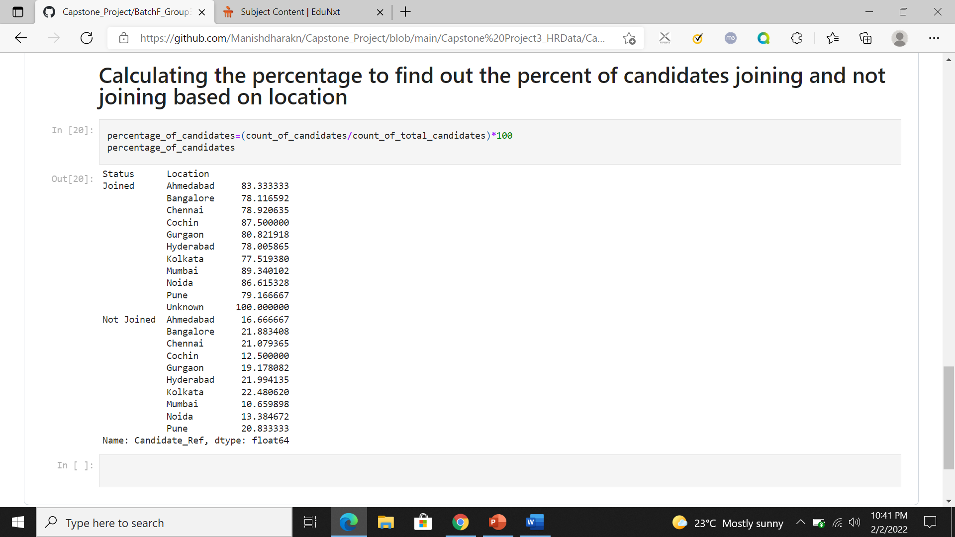
Problem Statement 1 – Are there specific locations where candidates are not joining?
Approach to the problem and the solution –
The approach to this problem here is to calculate the percentage of candidates who are having ‘Joined’ OR ‘Not Joined’ status based on the location.
The Inference from the output is that there are no specific locations where candidates are not preferring to join at all , although few locations are having percentage of candidates having status ‘Not Joined’ between 20% to 23%.

